Slide 1
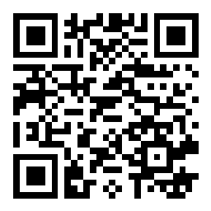
RTD.G.6
Common Knowledge and Data Management Service

Slide 2
Why the Horizon Results Booster?
Horizon Results Booster
Service offered by the European Commission to beneficiaries to maximize the impact of research & innovation project results:
Improving your exploitation potential
Helping you implement your dissemination and exploitation strategy
Increasing the dissemination and valorising your research
Widening your access to the market, policy makers and the society
Boost your impact!

Slide 3
Why the Horizon Results Booster?
Horizon Results Booster
A set of 3 tailor-made support services for beneficiaries
Clustering R&I projects, in a portfolio of similar/complementary project results
Development of exploitation potential
Improving the access to market
Free of charge
Portfolio Dissemination & Exploitation Strategy
Go To Market
Business Plan Development

Slide 4
Horizon Results Booster
The Horizon Results Booster is run under a framework contract managed by the European Commission
The Booster services are implemented by external consultants under confidentiality agreement and are available for FP7 and H2020 and Horizon Europe beneficiaries

Slide 5
Why the Horizon Results Booster?
Agenda
1. Horizon Results Booster: The Rules of the Game
Alicja Okoniewska - European Commission, Directorate-General for Research & Innovation, Common Knowledge and Data Management Service
Alessia Melasecche Germini - META Group
2. Service 1: Portfolio Dissemination & Exploitation Strategy (PDES)
Module A, B and C - Nicholas Ferguson TRUST-IT & Antonello Fiorucci META Group
Testimonial: Lourdes Morillas - Med'n'Change
3. Service 2: Business Plan Development (BPD)
Antonello Fiorucci - META Group
Testimonials: Ainhoa Cortés - WATEREYE , Ángel Moya - MEISTER
4. Service 3: Go-To-Market (GTM)
Alessia Melasecche Germini - META Group & Anna Franciosini - Ciaotech / PNO Consulting
Testimonial: Edward Someus - REFERTIL
5. Q&A and closing remarks
Boost your impact!

Slide 6
Join at slido.com
#HRB

